Slide 1



W3C WoT Meeting
Digital Twin Thing Descriptions
Ontology Engineering Group,
Universidad Politécnica de Madrid
Salvador González Gerpe, Andrea Cimmino
Raúl García-Castro
salvador.gonzalez.gerpe@upm.es
10/2023
Notes:
Representing Digital Twins and their information resources with WoT

Slide 2
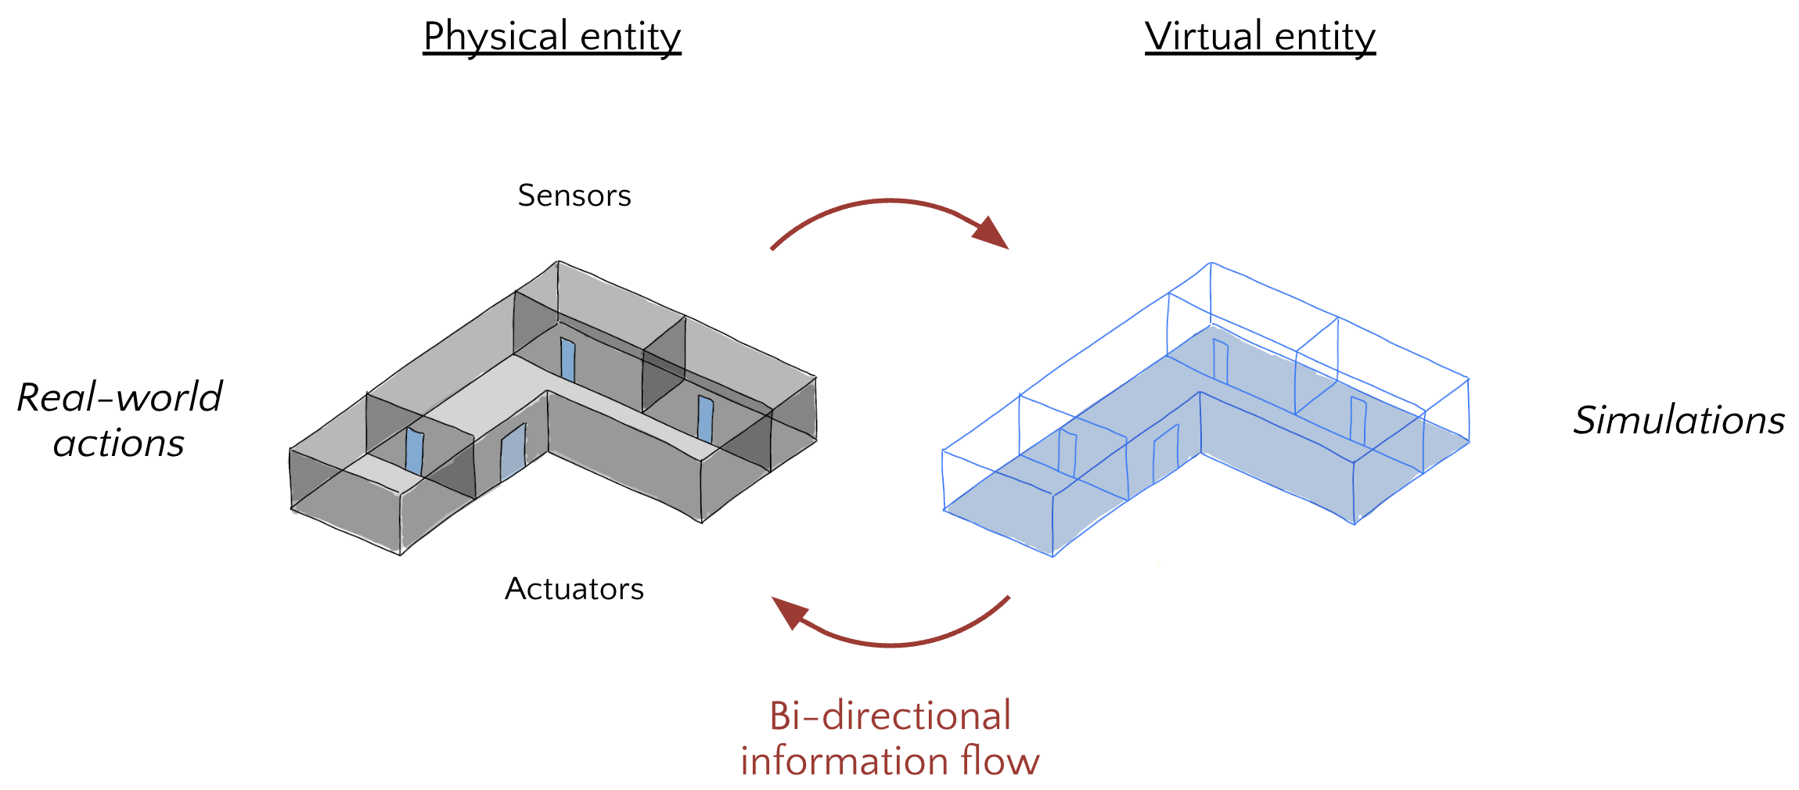
What are Digital Twins?

Slide 3
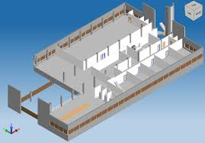
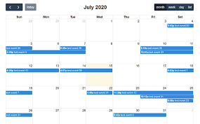

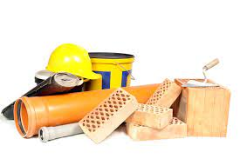
What are Digital Twins?

Slide 4
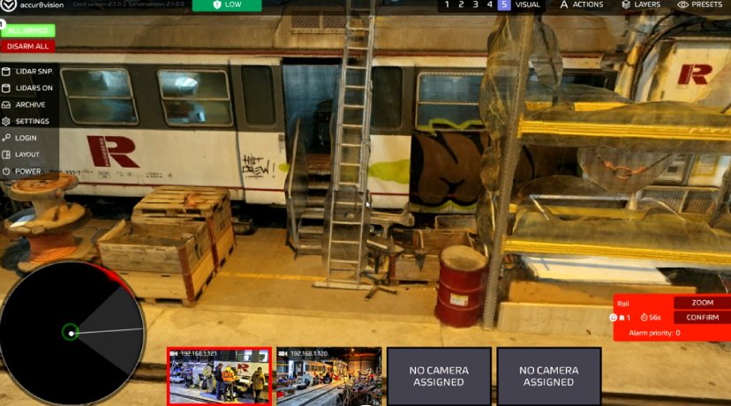
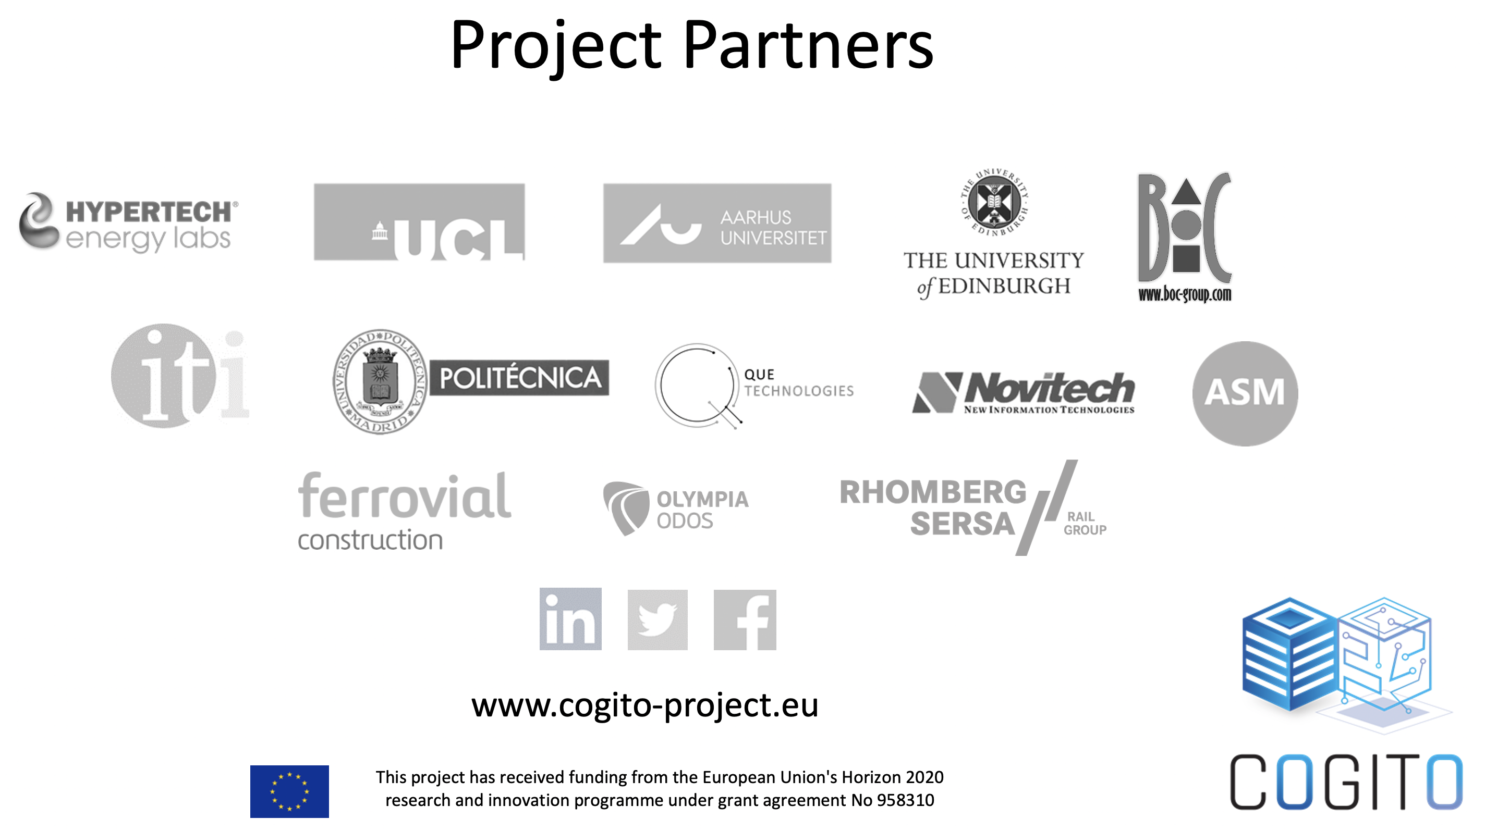
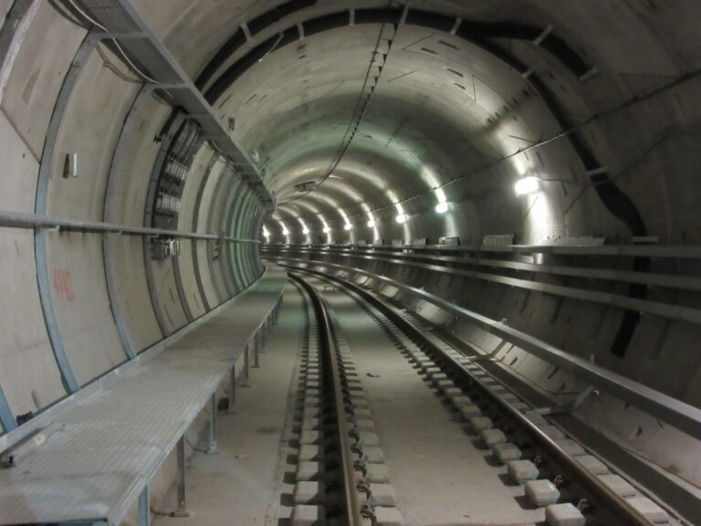
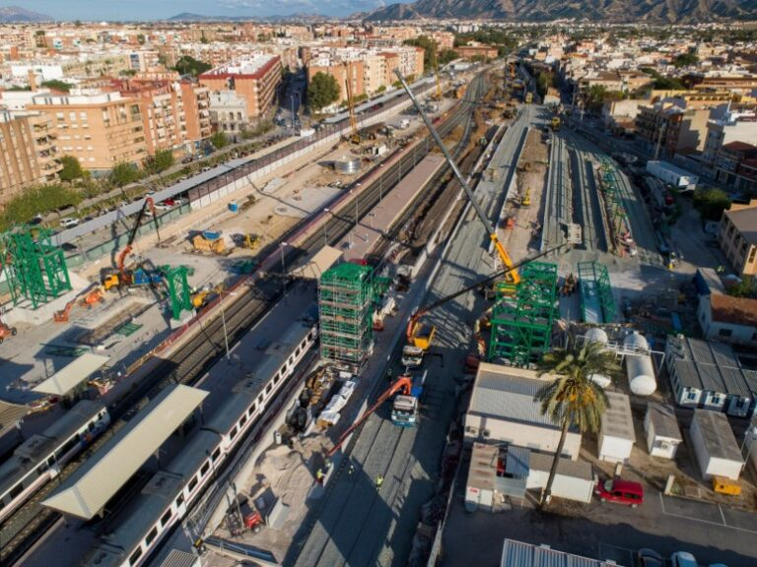
COGITO Project
COnstruction-phase diGItal Twin mOdel
Testlab - Austria
Pilot Site I - Denmark
Pilot Site II - Spain

Slide 5
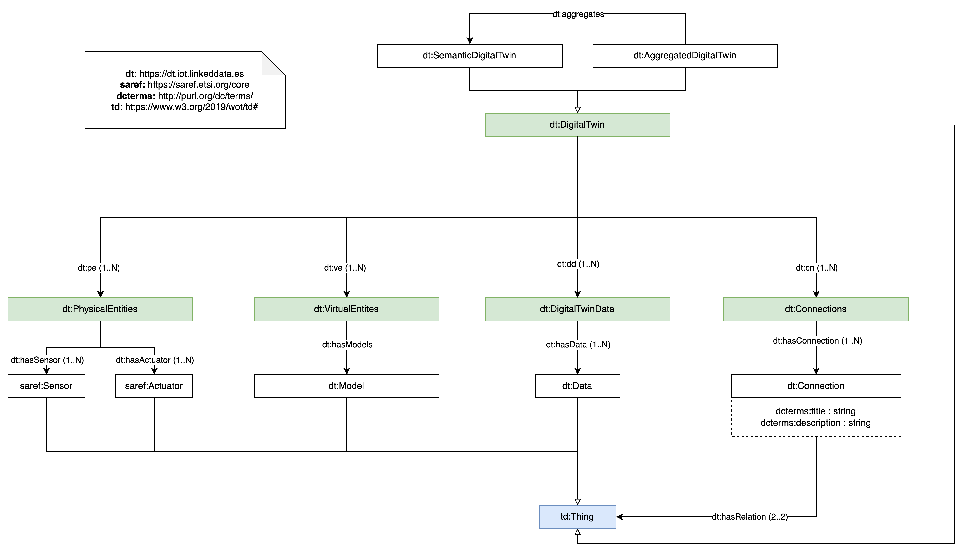
Ontology

Slide 6
Thing Description
{
"@context": [
"https://www.w3.org/2022/wot/td/v1.1",
{
"dt": "https://digitaltwin.iot.linkeddata.es/def/dt#",
"data": "https://digitaltwin.iot.linkeddata.es/resources/",
"saref": "https://w3id.org/saref#"
}
],
"id": "data:SDT-TD-1",
"@type": "dt:DigitalTwin",
"title": "Digital Twin Thing Description",
"description": "A Digital Twin with semantic data.",
"base" : "https://digitaltwin.iot.linkeddata.es/resources/SDT-TD-1/",
"securityDefinitions": {
"basic_sc": {"scheme": "basic", "in": "header"}
},
"security": "basic_sc",
...

Slide 7
Thing Description First Modification
"pe": [
{
"id": "data:SDT-TD-1/pe/1",
"@type": "dt:PhysicalEntity",
"description": ”Physical entity 1 of data:SDT-TD-1",
"devices": {
"hasSensor": [
{
"@type": "saref:Sensor",
"href": " data:SDT-TD-1/pe/1/sensor/1/td"
}
],
"hasActuator": [
{
"@type": "saref:Actuator",
"href": " data:SDT-TD-1/pe/1/actuator/1/td"
}
]}
}
], ...

Slide 8
Thing Description Second Modification
"ve": [
{
"id": "data:SDT-TD-1/ve/1",
"@type": "dt:VirtualEntity",
"description": "Virtual entity 1 of data:SDT-TD-1",
"hasModels" : [{
"@type": "dt:OntologyModel",
"description": "Ontology model of data:SDT-TD-1",
"href": "https://cogito.iot.linkeddata.es/def/"
},{
"@type": "dt:SHACLModel",
"description": "SHACL model used to validate semantic data generated in data:SDT-TD-1",
"href": "data:SDT-TD-1/ve/1/model/shacl_shapes.ttl"
},{
"@type": "dt:MappingsModel",
"description": "Mappings model used to generate semantic data in data:SDT-TD-1",
"href": "data:SDT-TD-1/ve/1/model/mappings.rml"
},{
"@type": "dt:GeometricModel",
"description": "Geometric model of data:SDT-TD-1",
"href": "data:SDT-TD-1/ve/1/model/geometric_model.ifc"
}, {
"@type": "dt:PhysicalModel",
"description": "Physical model of data:SDT-TD-1",
"href": "data:SDT-TD-1/ve/1/model/physical_model.json"
}, ...]
}
] ...

Slide 9
Thing Description Third Modification
"dd": [
{
"id" : "data:SDT-TD-1/dd/1",
"@type": "dt:DigitalTwinData",
"description": "Digital twin data 1 of data:SDT-TD-1",
"hasData" : [
{
"@type": "dt:KnowledgeGraph",
"description": "Knowledge graph of data:SDT-TD-1",
"href": "data:SDT-TD-1/dd/1/kg.ttl"
},
{
"@type": "dt:InformationResource",
"description": "Information resource IFC file of data:SDT-TD-1",
"href": "data:SDT-TD-1/dd/1/ifc_file.ifc"
}
]
}
], ...

Slide 10
End of Thing Description without modifications
"properties": {
"dt_service_1_status": {
"type": "string",
"forms": [{"href": "https://digitaltwin.iot.linkeddata.es/status"}]
}},
"actions": {
"dt_service_1_action": {
"forms": [{"href": "https://digitaltwin.iot.linkeddata.es/action"}]
}},
"events": {
"dt_service_1_event": {
"data": {"type": "string"},
"forms": [{
"href": "https://digitaltwin.iot.linkeddata.es/event",
"subprotocol": "longpoll"
}]
}},
"links" : []
}

Slide 11
W3C WoT Meeting
Digital Twin Thing Descriptions
Ontology Engineering Group,
Universidad Politécnica de Madrid
Salvador González Gerpe, Andrea Cimmino,
Raúl García-Castro
salvador.gonzalez.gerpe@upm.es
10/2023

Slide 12
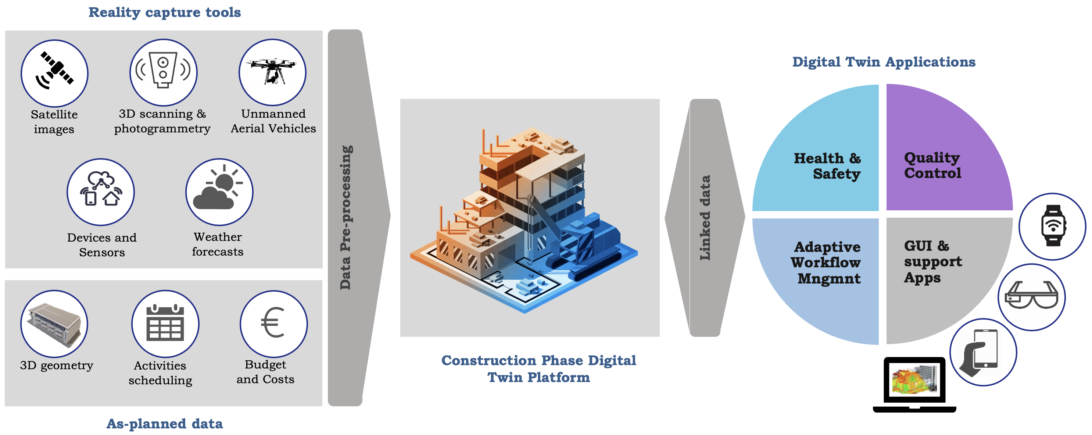
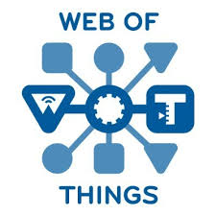
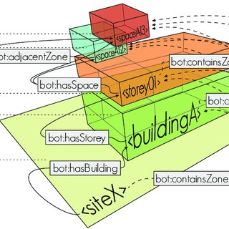



COGITO Project
OPEN STANDARDS
SAREF
BOT
BRICK

Slide 13
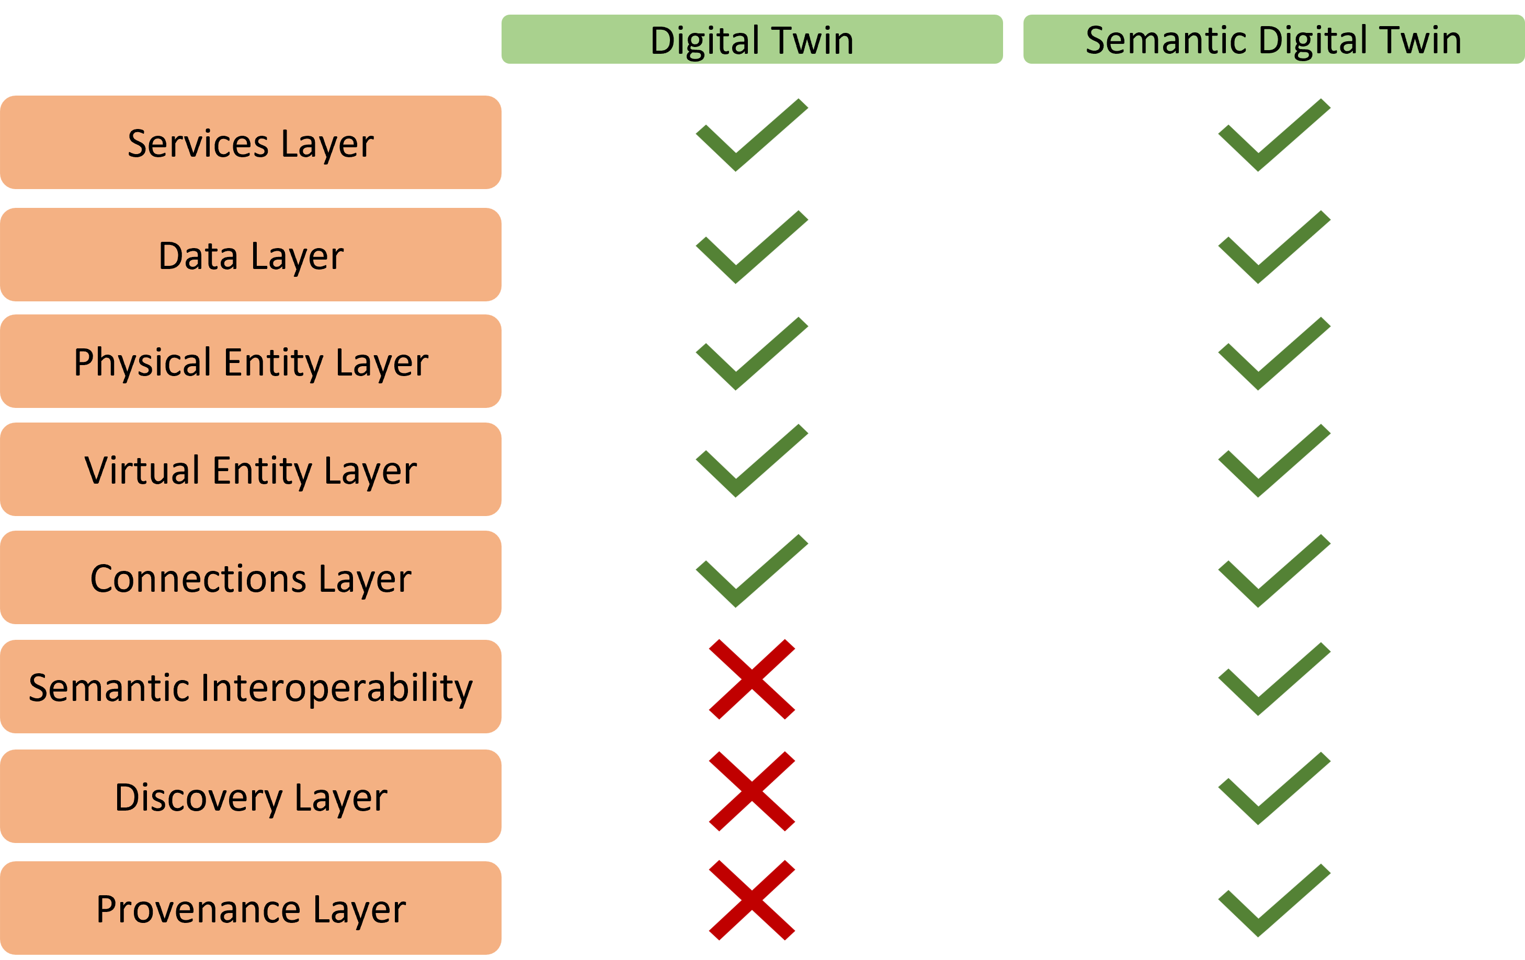
Semantic Digital Twin

Slide 14

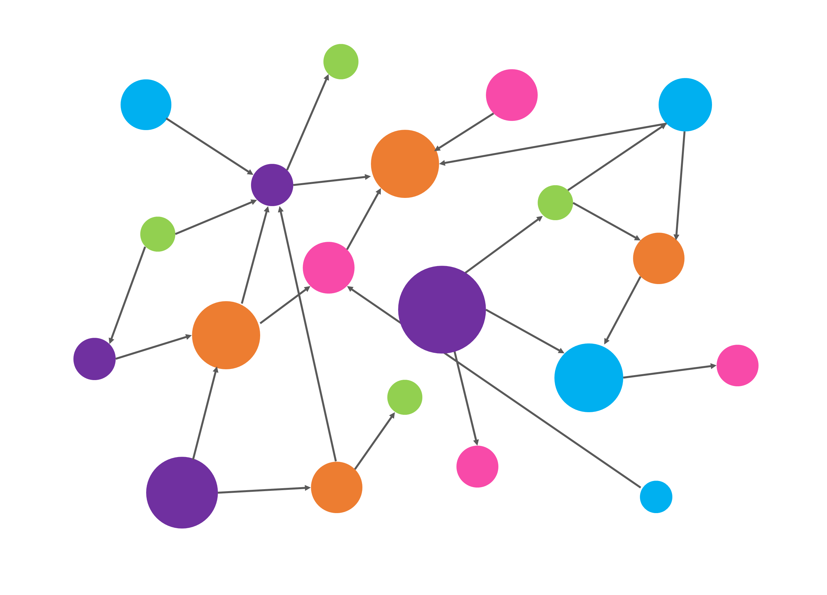

Data distribution in COGITO Semantic Digital Twin
Relational DB
(Project Data)
Key-Value DB
(IFC Data)
Timeseries DB
(IoT Data)
BIM Data Post-processing Services
Triplestore DB
(Semantically Linked Data; RDF)
Extraction, Transformation &
Loading Services
Data Management Services

Slide 15



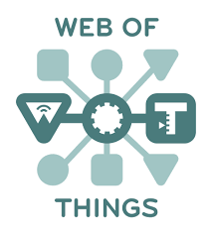
Semantic Interoperability in Digital Twins
Ontology
Services
Heterogeneous Data
Homogeneous Data
Data
Virtual Entity
Physical Entity
Data Harmonization
Data Enrichment
Connections
Semantic Model
Heterogeneous Data
Homogeneous Data
Provenance

Slide 16
Semantic Interoperability in Digital Twins
Ontology
Services
Heterogeneous Data
Homogeneous Data
Data
Virtual Entity
Physical Entity
Data Harmonization
Data Enrichment
Connections
Semantic Model
Heterogeneous Data
Homogeneous Data
Provenance

Slide 17
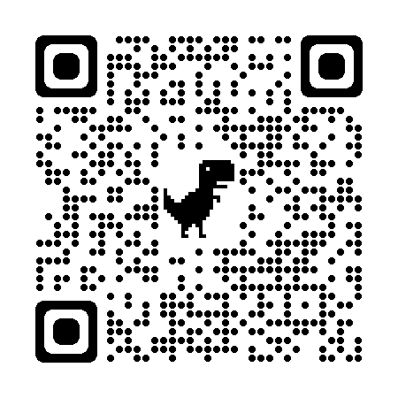
COGITO ontologies classes described as Digital Twins
COGITO Ontologies
Facility
Resources
Process
?
Digital Twin
Quality
Safety
IoT
Notes:
What kind of data decrypted in the ontologies can be represented as Digital Twins

Slide 18
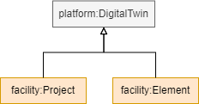
COGITO ontologies classes described as Digital Twins
COGITO Ontologies
Facility
Resources
facility:Project
facility:Element
Process
Digital Twin
Quality
Safety
IoT
Notes:
Los facility:Project y los facility:Element serán los clases en este proyecto que serán representadas como Digital Twins.

Slide 19
COGITO Ontology extension
COGITO Ontologies
Facility
Resources
Process
Platform
W3C Thing Description ontology
Quality
Safety
IoT
Notes:
Con el objetivo de no perder el provenance en el Semantic Digital Twin, se ha procedido a definir cada Digital Twin como un td:Thing, referente a la ontología perteneciente a los Thing Descrptions. Para ello se ha creado una extensión en las ontologías que describe los datos descritos como Digital Twins, como td:Things con el objetivo de poder definir los Digital Twins como Thing Descriptions. La extensión de estas ontologías se ha definido como Platform.

Slide 20
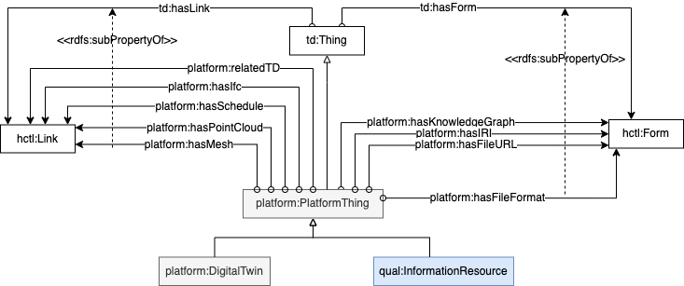
COGITO Platform Ontology

Slide 21
COGITO Semantic Digital Twin backbone based on WoT
Relational DB
(Project Data)
Key-Value DB
(IFC Data)
Timeseries DB
(IoT Data)
BIM Data Post-processing Services
Triplestore DB
(Semantically Linked Data; RDF)
Extraction, Transformation &
Loading Services
Data Management Services

Slide 22



COGITO Semantic Digital Twin backbone based on WoT
Query
Discovery
Semantic DT Components

Slide 23

Conclusions
Digital Twins have lots of data and has to be handled.
The development of a Semantic Digital Twin allows the management of all data to be semantically interoperable.
In order to not lose the heterogeneous data belonging to the main entities described as Digital Twins, a WoT-based backbone has been developed, allowing the maintenance of the provenance belonging to all the data of the defined Digital Twin.
In addition, thanks to the WoT layer given by the Thing Descriptions, discovery can be performed in order to obtain all the information concerning a particular Digital Twin in a more straightforward form.

